Slide 1
Capstone Project-1
Hotel Booking Analysis by- Team fantastic five: Souvik Bhattacharyya Abhishek Kumar Verma Shreyash Pattnayak Aseem Bharadwaj Achin Gupta

Slide 2
Contents:
Abstract
Phase-1
1. Data Exploration
2. Data Pre-Processing (Data Cleaning, Data Transformation and Data Reduction)
Phase-2
1. Booking percentage in different types of hotels
2. Yearly bookings for 2015, 2016 & 2017
3. Bookings that were mot cancelled. 4. Monthly footfall of different types of guests
5. Nationality of all the guests.
6. Average Daily Rate (ADR) V/s Arrival Month.

Slide 3
Contents:
Phase-2 (Continued)
7. ADR V/s Arrival Days of Month.
8. The most booked accommodation type (Single, Couple, Family).
9. Source of booking
10. Relation between Lead Time and Cancellation
11. Do market segments have any impact on Repeated customers?
12. Required number of Parking Spaces.
13. Duration of the Stay.
14. Preferred types of meals.
15. Total special requests for different types of hotels.
Conclusion

Slide 4
ABSTRACT
In this project we attempt to understand the trends so that we could estimate the best time to book a room at a hotel and the optimal length of stay. we also calculated the factors that affect the monthly footfall of a hotel using the Hotel Booking Dataset provided to us.
This data set contained booking information for different City hotels and Resorts and included information such as when the booking was made, length of stay, the number of adults, children, and/or babies, etc..
We explored and analysed the data to discover the Key Performance Indicators (KPI) that govern the bookings and prove us with the necessary information behind the underlying principles.

Slide 5
PHASE 1 DATA EXPLORATION & DATA PRE-PROCESSING
Data Exploration is the first step of data analysis used to explore and visualize data to uncover insights from the start or identify areas or patterns to dig into more.
Then we proceed towards Data Pre-processing which includes data cleaning, data transformation and data reduction which will enhance the performance and understanding of a dataframe.
Data Cleaning: The data can have many irrelevant and missing parts. To handle this part, data cleaning is done. It involves handling of missing data, noisy data etc.
Data Transformation: This step is taken in order to transform the data in appropriate forms suitable for mining process.
Data Reduction: Since data mining is a technique that is used to handle huge amount of data. While working with huge volume of data, analysis became harder in such cases. In order to get rid of this, we uses data reduction technique. It aims to increase the storage efficiency and reduce data storage and analysis costs.

Slide 6
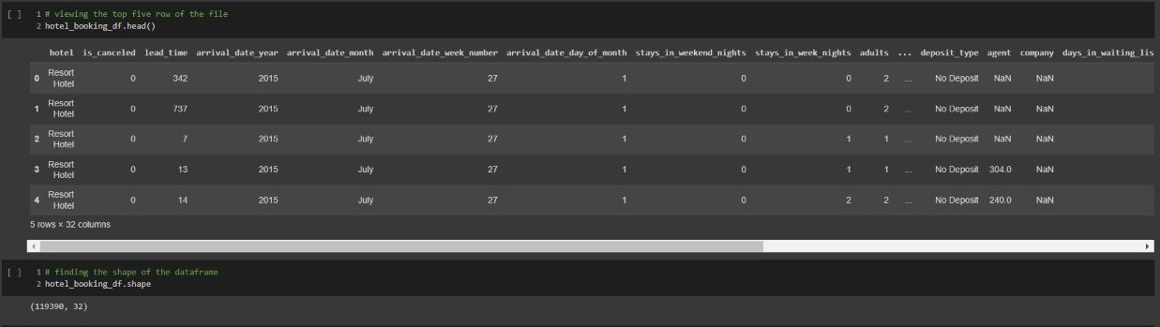
COMMAND LINE FOR DATA EXPLORATION

Slide 7
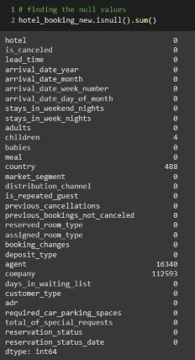
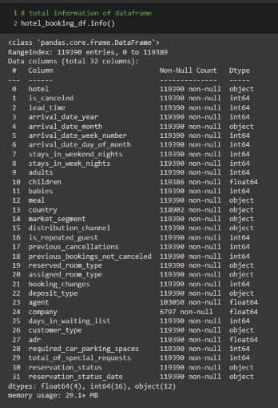
COMMAND LINES FOR DATA DATA EXPLORATION

Slide 8
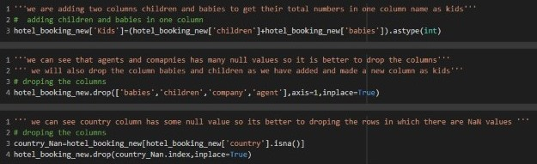
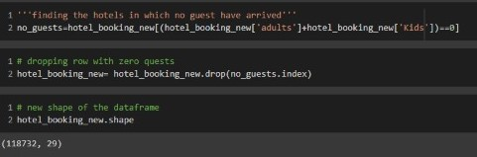
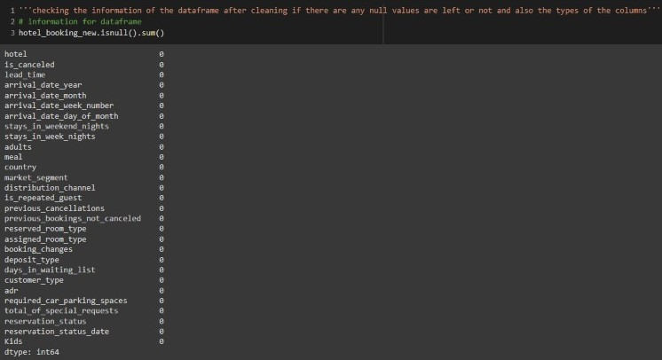
COMMAND LINES FOR DATA PRE-PROCESSING
Notice that earlier the data size was [119390,32] & after required procedures in Pre-Processing, the shape of the data has reduced to [118732,29]
The last image is a tabular confirmation on if the null values have been eradicated off the new Data shape..

Slide 9
BEFORE PRE-PROCESSING THE DATASET
AFTER PRE-PROCESSING THE DATASET

Slide 10
PHASE-2

Slide 11
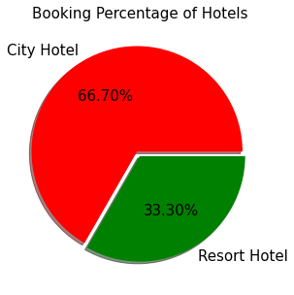
Booking percentage between Resort Hotel and City Hotel
We can see 2/3 guests prefer city hotels over resorts.
City hotels would be more affordable than resort hotels due to accessibility, reliability and lavishing factors.

Slide 12
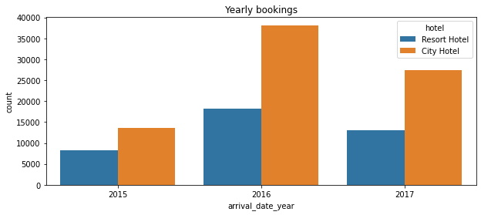
Yearly bookings for each year given in the Dataframe
It could be seen from the visual aid that the trend from 2015 to 2016 is increasing.
While the average rate of inflation in the number of guests opting for resorts increased by 63%, the number of guests in city hotels escalated to 266% of the previous year.
2017, on the other hand showed a downward tajectory in the daily footfall in both kinds of hotel, showing are decline of 29% on an average

Slide 13
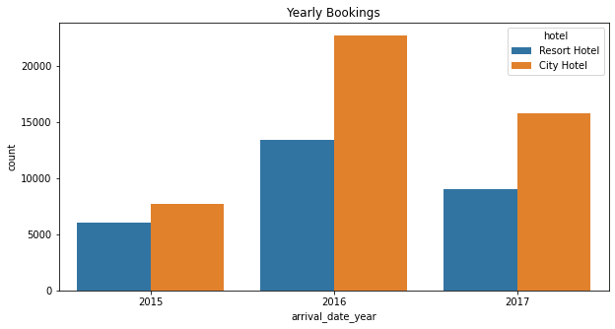
Bookings that were not cancelled.
In 2015, The city hotels' section saw an average non cancellation rate of 0.56, while resorts had the rate around resort 0.76
The same for 2016 would be 0.61 and 0.72 for city hotels' and resorts' respectively.
It has been observed that guests are more likely to not cancel on bookings with a resort.
As for 2017, the non cancellation rates were 0.57 and 0.70 for city hotels' and resorts' respectively.

Slide 14
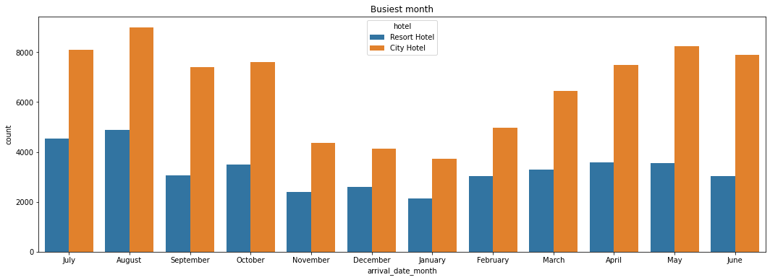
Monthly footfall in different types of hotels
The trajectory of the graph is in the shape of a BELL CURVE. This suggest that the middle of the year are some of the busiest time, peaking at August, over the period of 3 years.

Slide 15
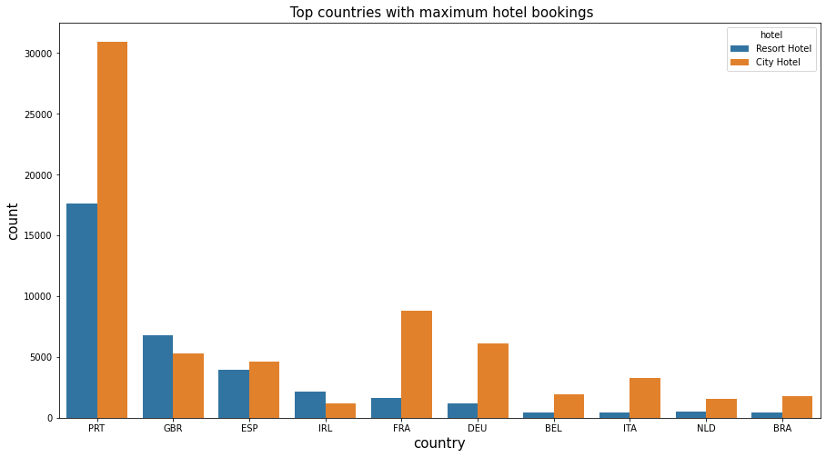
Nationality of the guests
The visual aid suggests that Portuguese are the most popular guests at both the type of hotels. Other prominent nationalities are British, Espanol, Irish, French, etc., in the same order. Aside from visitors from The Great Britain and Ireland, guests mostly prefer to stay at city hotels.

Slide 16
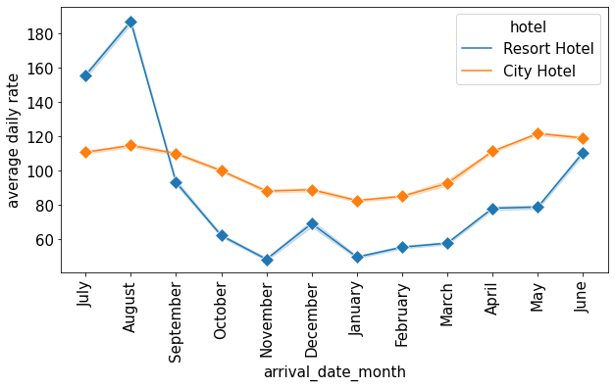
ADR V/s Arrival Month.
It has been observed that the average cost of staying for a guest in city hotels remains somewhat constant, fluctuating within a range of 100 to 120.
Whereas in the case of Resorts, there is a spiked in the month of August.
The minimum ADR is observed from January to March and then from October to November. The local maxima at December suggests an influx of guests for the occasion of The New Year.

Slide 17
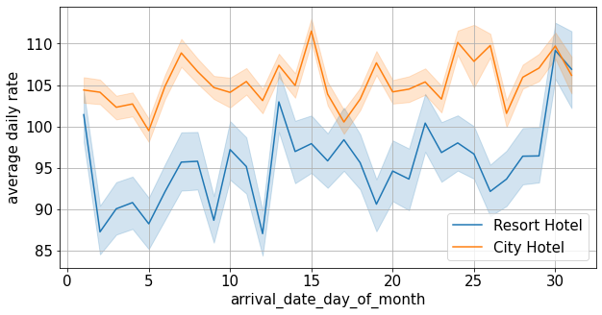
ADR VS Arrival Days of Month

Slide 18
ADR VS Arrival Days of Month
On a cursory glance, we can observe that City hotels have higher ADR compare to Resorts. We can see that the end of month is the busiest time thusly leading to higher ADR in both the type of hotels. It would be justified from the graph that beginning of the month (starting from day 2 to day 9) are the quietest time leading to lower ADR.

Slide 19
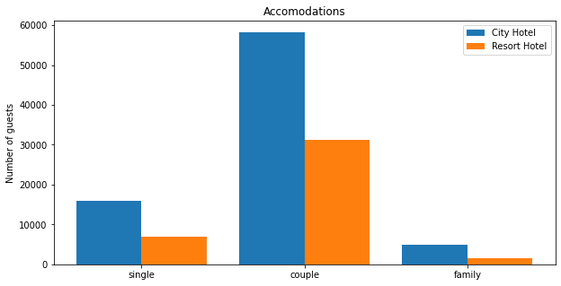
The most booked accommodation type(Single, Couple, Family)
While family type bookings were the least popular kind, the graph suggests that couples formed the largest topography of guests ranging to 75.5% of the total customer list

Slide 20
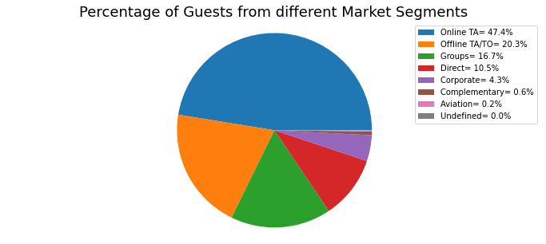
Source of bookings
The maximum number of bookings were done through Online Agents (at 47.4%).
Another prominent source of booking was done through Offline methods (at 20.3%). Other methods of booking include Groups, Direct, Corporate, etc., forming the remaining 32.3%.

Slide 21
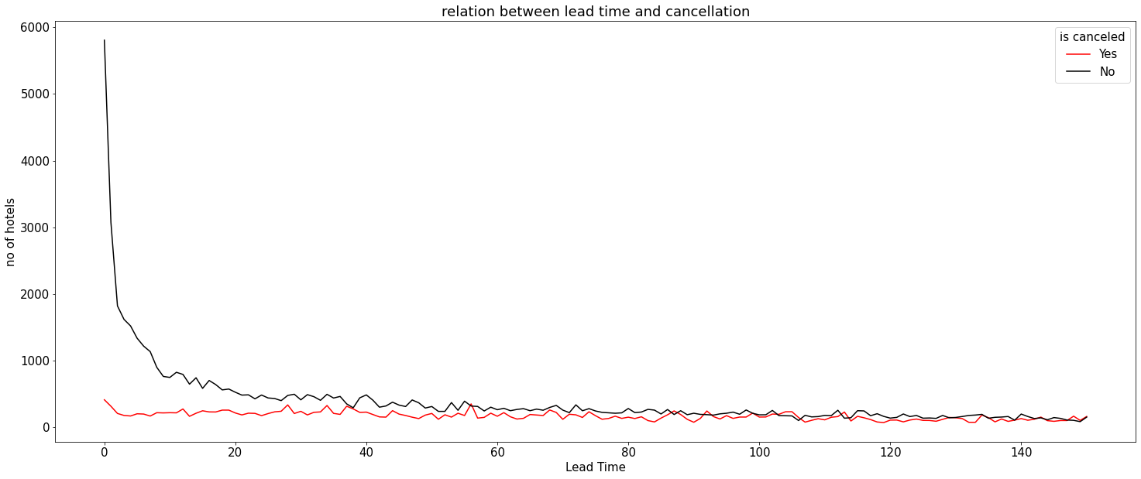
Relationship between lead time and cancellation

Slide 22
Relationship between lead time and cancellation
From the aforementioned graph, on a cursory glance it is visible that, majority of the guests book their prefer rooms as late as possible within a margin of 20 days.
It has also been observed that guests are likely to cancel more when they book their rooms of with a span of 80 days or more as their lead time(almost 50%).

Slide 23
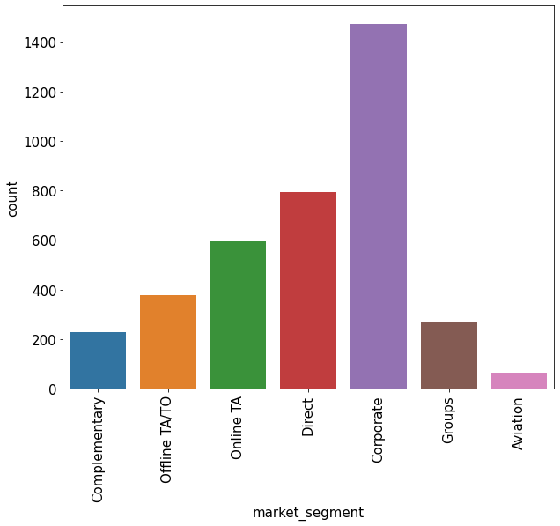
Market segment has any impact on repeated customer
Corporates are the largest customer base for hotels amounting for almost 40% of the market share, with the follower ups being Direct bookings, Online Travel agencies, etc.

Slide 24
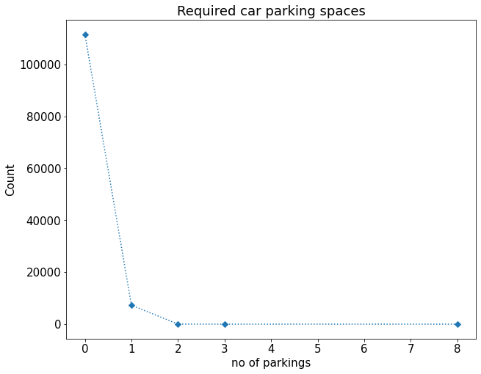
Required car parking spaces.
We can see that maximum customers doesnot requires Parking spaces

Slide 25
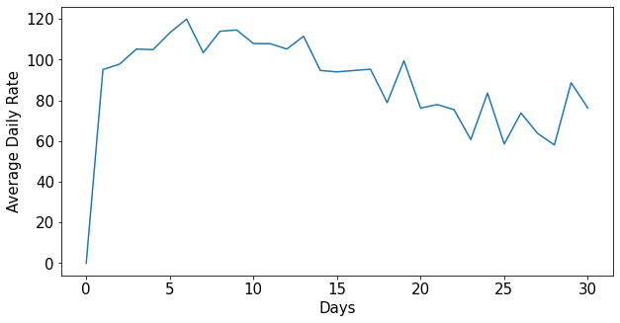
How long people stay in a hotel
We can observe from the graph that first 25 days average daily rate is very high after that average daily rate decrease sharply till 30 then we can see inclination and after that ADR reduces. A large no of guests
prefer to stay at a hotel for 5 to 15 days. Another local maxima can be observed at the 30 day interval suggeting a monthly stint.

Slide 26
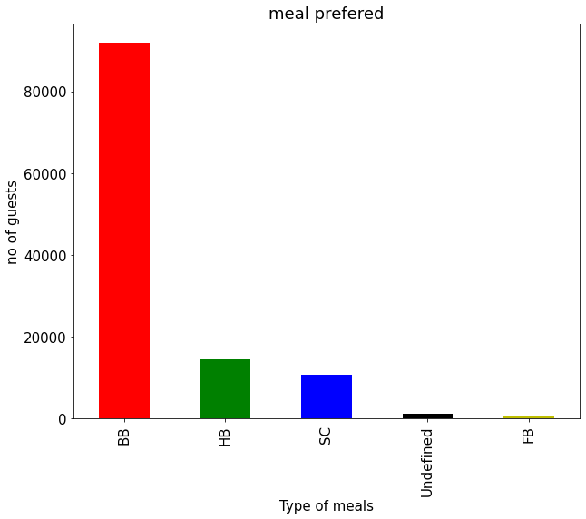
Preferred meals types.
As majority of the guests are staying for a short stint of up to 10 days they prefer to have (breakfast only) type meal, hence opting for BB. This demography suggests that guest are interested in visiting places , thusly not staying at the hotel for majority of time. Other popular option for fooding include HB, SC and FB.

Slide 27
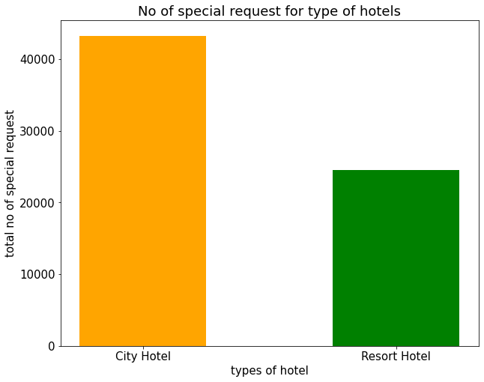
Total special requests from types of hotel.
It could be concluded from above graph that number of special request for the city hotel is 43300 and for resort hotel 24591. so the city hotel is more preferred than resort hotel by the guests.

Slide 28
CONCLUSION
The research concluded with the creation of data-points for guests to book suitable rooms for themselves by monitoring the trends. This data, being interactive improves the user experience and allows them to use this system as per their convenience. The background research aided in the formulation and validation of the problem statement and helped us create an information architecture.
This study allowed us to acquire insight into the processes that are followed while creating a booking token. Overall, the research accomplished our goals of comprehending how the hotel systems work and how we could avail them at an appropriate price point with suitable amenities. The implementation of the system would help guests better understand the structure involved in booking hotels on a regular basis.

Slide 29
THANK YOU

